Slide 1
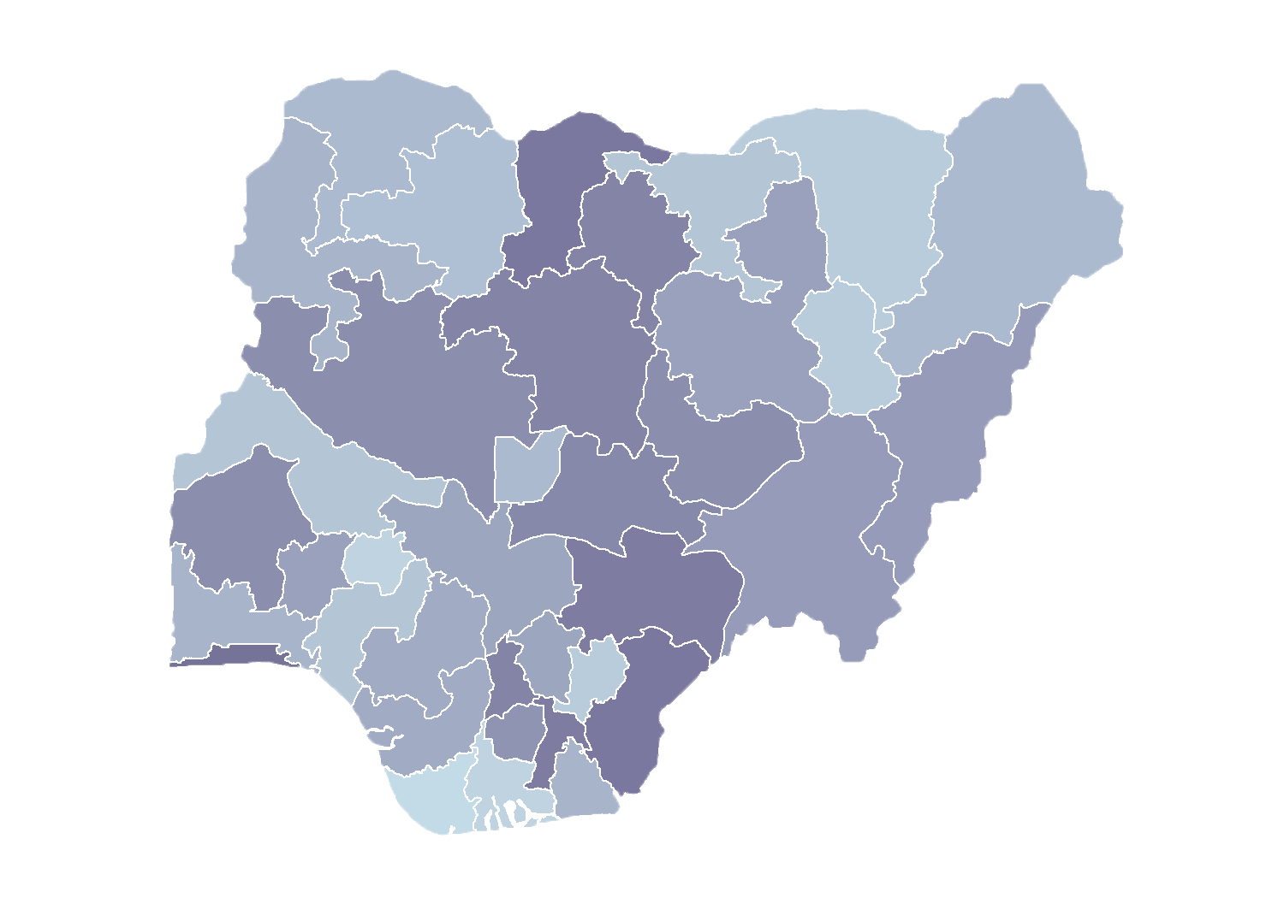
Module 1.3
Introduction to the HFR Administration Module
Rollout of Health Facility Registry/Master Facility List for States and Local Government Areas in Nigeria
June 2019

Slide 2
Outline
Account activation
System login
Layout and navigation
Updating profile
Change password
Password reset

Slide 3
Account activation

Slide 4
Activating your account
The system administrator is responsible for creating a user account for you.
Once the account is created, you will receive an email with your login details.
*Note: Do not respond to this email.*
Click on the login button and enter your email address and the temporary password provided.

Slide 5
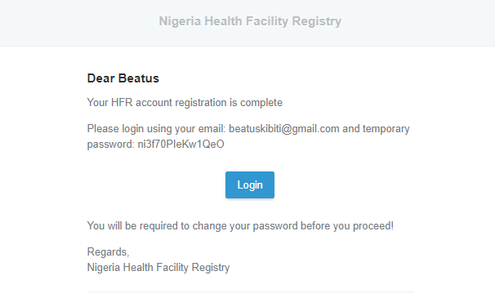
Activating your account
New account email message

Slide 6
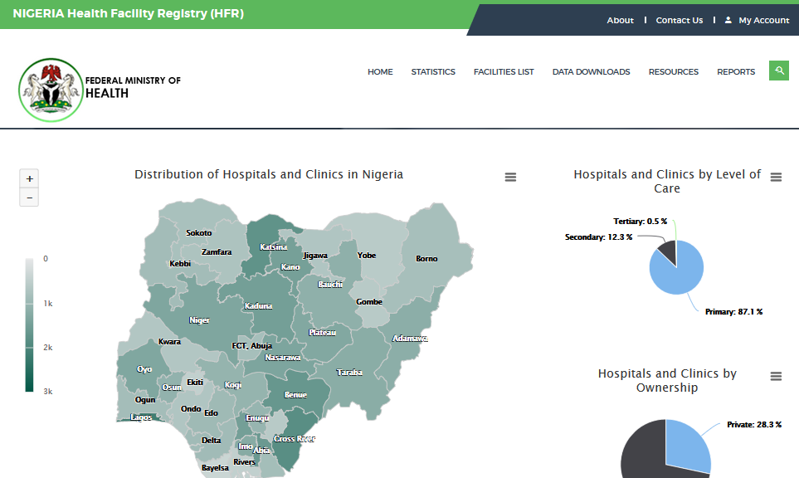
Activating your account
Log in
To log in, go to the HFR home page and click on My Account.

Slide 7
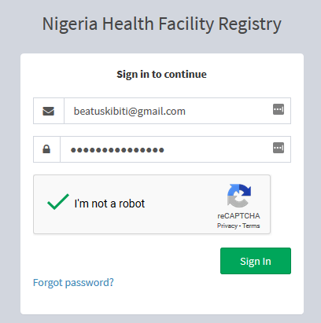
Activating your account
Log in
Click on the login button.
Enter your email address and the temporary password provided.
Verify that you are not a robot.
Click Sign In.
A verification code will be sent to your email address.

Slide 8
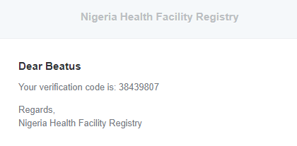
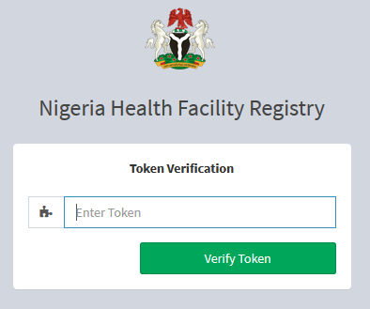
Activating your account
Token verification
Copy the verification code from your email message.
Enter the token in the Token Verification form.
Click Verify Token.

Slide 9
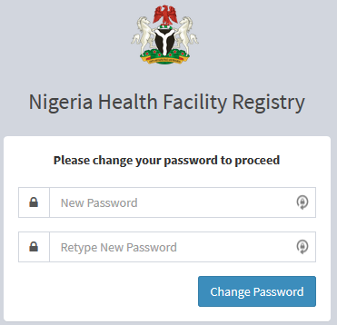
Activating your account
Change the password
You will be given a change password form.
Enter your new password and confirm the new password.
Click Change Password.
If successful, you will be logged in automatically.

Slide 10
Layout and
navigation

Slide 11
Layout
Dashboard
After successful login, you will see the system dashboard.
The menu items you see there depend on the user roles assigned to you.

Slide 12
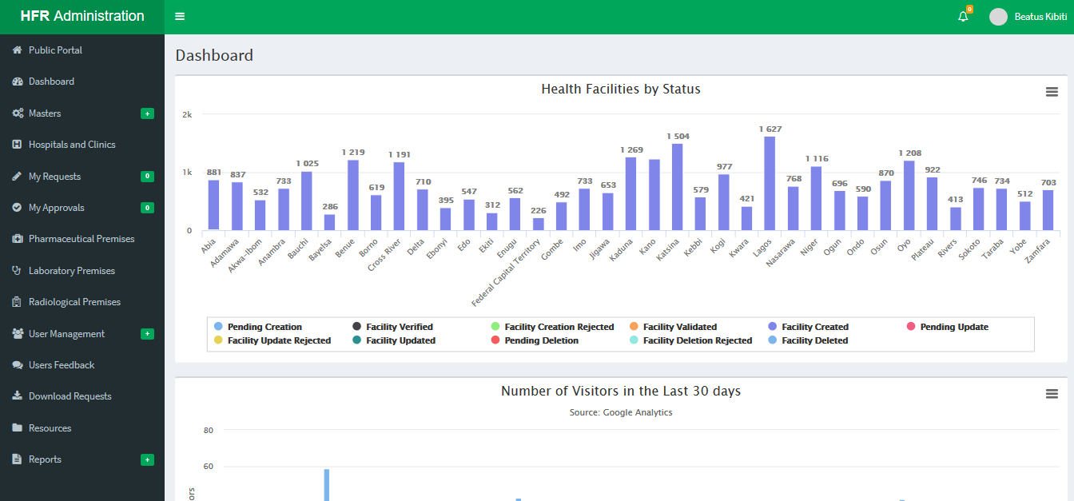
Layout

Slide 13
Layout
Click to collapse menu bar
System notifications
User profile
Click to expand menu
Menu bar
Dashboard

Slide 14
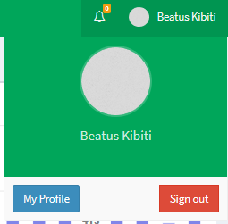
User profile
Click on your name, on the top right-hand side of the screen.
To log out of the system, click Sign out.
To view and update your profile, click My Profile.

Slide 15
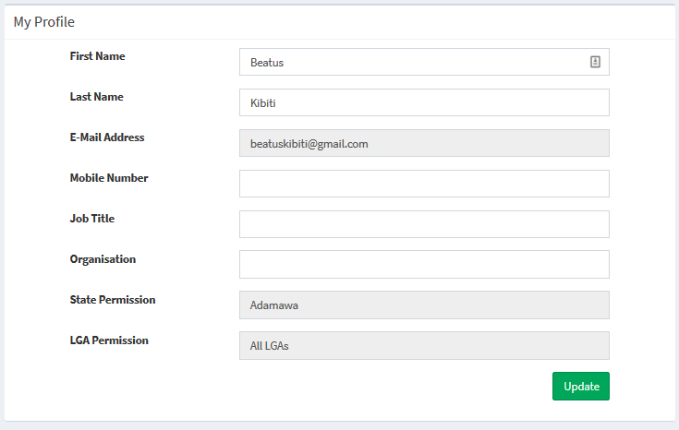
User profile
Update your profile
You may update only your name, mobile number, job title, and organization.
When you finish, click Update to save the changes.

Slide 16
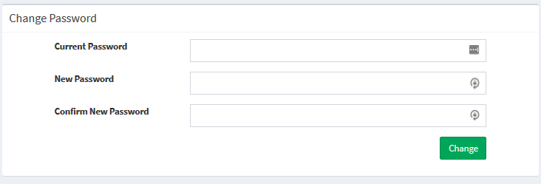
User profile
Change your password
To change your password, enter your current password.
Enter the new password and repeat the new password.
Click Change to save it.
Note: A password must contain a minimum of 8 characters.

Slide 17
Password
reset

Slide 18
Password reset
Use the reset password function when you forget your password.
The administrator cannot reset your password.
The system provides a mechanism to reset your password without the administrator’s assistance.

Slide 19
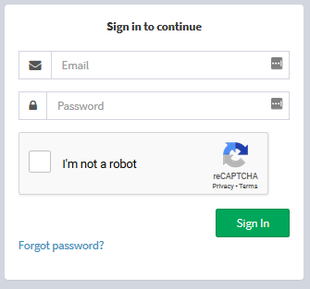
Password reset
To reset your password, go to the login page:
-> Public Portal -> My Account
On the login page, click Forgot password?.

Slide 20
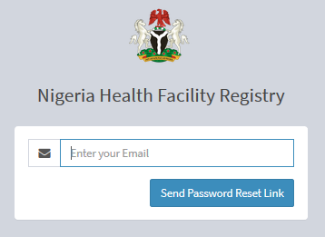
Password reset
Enter your registered email address.
Click Send Password Reset Link.
You will receive the following notification

Slide 21
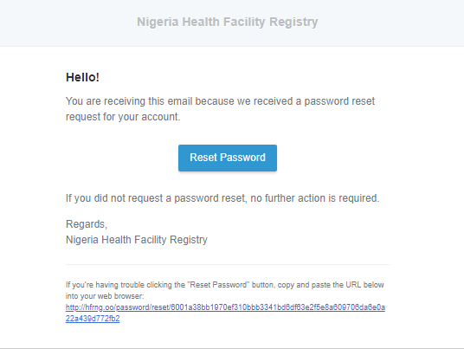
Password reset
Reset password notification
Click Reset Password.

Slide 22
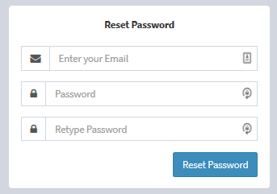
Password reset
New password
Enter your registered email address.
Enter the new password and retype it.
Then click Reset Password.
Your password will be reset, and you will automatically be logged into the system.

Slide 23
Activity

Slide 24
Practice
Account creation and activation
An administrator will create an account for each training participant.
Check your email messages for one notifying you that you have an account.
Follow the steps described in the message to activate your account in the test server.

